Slide 1

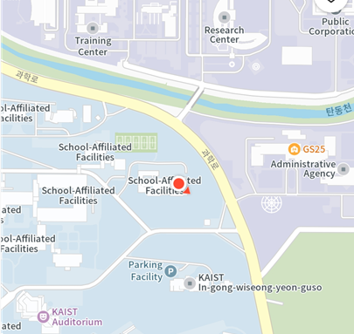
MoonLab.
Distributed & Robust Machine Learning Lab
Supervisor : Jaekyun Moon
(Professor in the School of EE/AI at KAIST)
Contact Details
617 N1, School of EE, KAIST, 201, Daehak-ro, Youseong-gu, Daejeon
E-mail: jmoon@kaist.edu
Webpage: moonlab.kaist.ac.kr
Phone: 042-350-8087
Notes:
안녕하십니까, 이번 ADD 공개채용에 지원한 박영현입니다.
제가 응시한 모집분야의 직무수행 내용은 “물체인식 기술”, “학습 데이터베이스 구축“, “온디바이스 AI 기술”으로 총 3가지이며,
저는 이 3가지 기술에 각각 대응되는 연구를 수행하였습니다.
지금부터, 각 직무 수행 내용과 관련되는 저의 연구들을 소개드린 후,
마지막에는 ADD에서의 연구계획을 말씀드리며 마무리짓도록 하겠습니다.

Slide 2
MoonLab Research Topic
1
Research Direction
We are a research group headed by Prof. Jaekyun Moon. We work on distributed/federated learning, robust AI, and resource-efficient AI, addressing critical issues for AI systems that arise in practical deployments.
Topic 1
Distributed/Federated Learning
Topic 2
Robust AI against Domain Shifts/Attacks
Topic 3
Resource-Efficient AI
Communication-Efficient FL
[ICML’24] Achieving Lossless Gradient Sparsification via Mapping to Alternative Space in Federated Learning
[NeurIPS’23] EvoFed: Leveraging Evolutionary Strategies for Efficient and Privacy-Preserving Federated Learning
Federated Domain Generalization
[NeurIPS’23] StableFDG: Style and Attention Based Learning for Federated Domain Generalization
Robust AI against Adversarial Attacks
[NeurIPS’23] NEO-KD: Knowledge-Distillation-Based Adversarial Training for Robust Multi-Exit Neural Networks
[NeurIPS’21] Sageflow: Robust Federated Learning against Both Stragglers and Adversaries
OOD Generalization/Calibration
[AAAI’24] Consistency-Guided Temperature Scaling Using Style and Content Information for Out-of-Domain Calibration
[ICML’23] Test-Time Style Shifting: Handling Arbitrary Styles in Domain Generalization
Few-Shot/Round Learning
[ICLR’23] Warping the Space: Weight Space Rotation for Class-Incremental Few-Shot Learning
[NeurIPS’21] Few-Round Learning for Federated Learning
Active Learning
[ICLR’23] Active Learning for Object Detection with Evidential Deep Learning and Hierarchical Uncertainty Aggregation
2

Slide 3
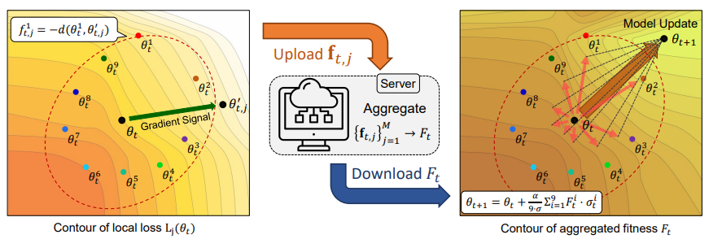
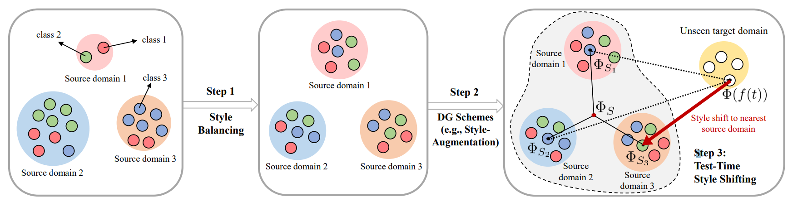
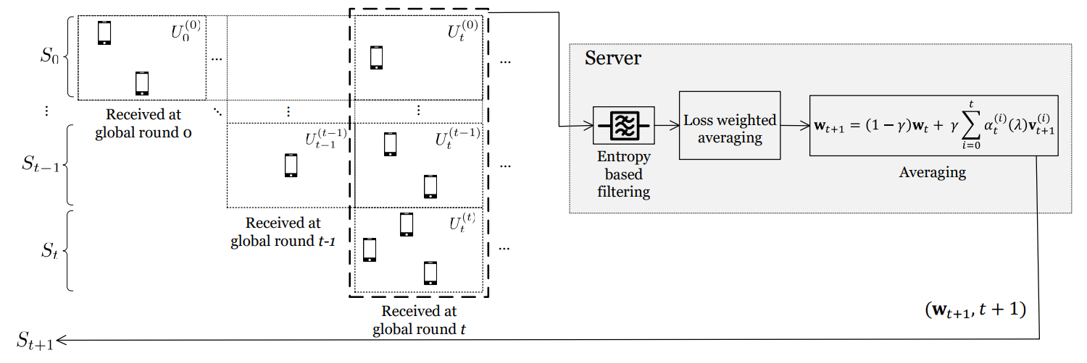
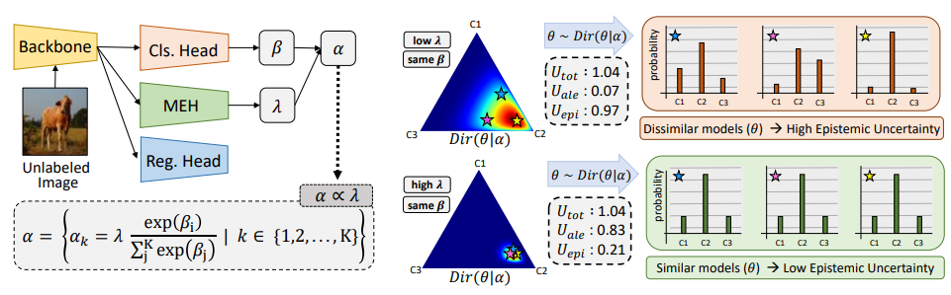
MoonLab Research Portfolio
2
Evolutionary Strategies for Communication-Efficient FL [NeurIPS’23]
Test-Time Style Shifting for Domain Generalization [ICML’23]
Efficient federated learning via the exchange of lightweight fitness score between devices sharing the same seed
Style-balancing and test-time style shifting to handle arbitrary domains for domain generalization
Robust FL against Stragglers and Adversarial Attacks [NeurIPS’21]
Active Object Detection with Evidential Deep Learning [ICLR’23]
Entropy-based filtering and loss-weighted averaging against adversarial attacks in FL
Box-wise and image-wise informativeness prediction using Bayeisan learning and hierarchical information aggregation

Slide 4
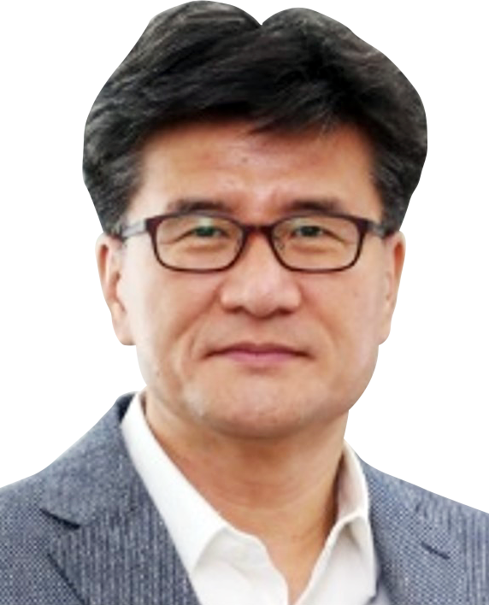
Introduction to the Laboratory
3
MoonLab - Storage, Communications & Machine Learning
Dean, College of Engineering, KAIST since 2023
Main interests in distributed/federated Learning, robust AI against domain shifts/attacks and resource-efficient AI.
Published more than 100 international journals and 50 conference papers including top AI/ML conferences (ICML, NeurIPS, ICLR).
Prof. Jaekyun Moon
IEEE Fellow since 2005
Career
23.03 ~ Current
Dean, College of Engineering, KAIST
Head, School of EE, KAIST
<Recent research topics>
16.09 ~ 20.08
Federated Learning and Efficient Machine Learning
Test-Time Adaptation and Domain Generalization
Domain-Specific Personalization of Foundation Model
09.05 ~ Current
Prof., School of EE, KAIST
08.01 ~ 08.12
Link-A-Media Devices Corp Chief Technology Officer
99.09 ~ 09.04
Prof., University of Minnesota

Slide 5
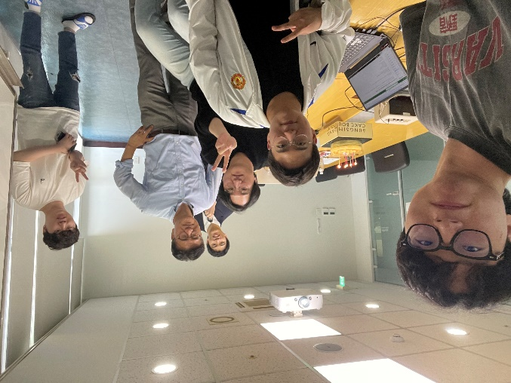
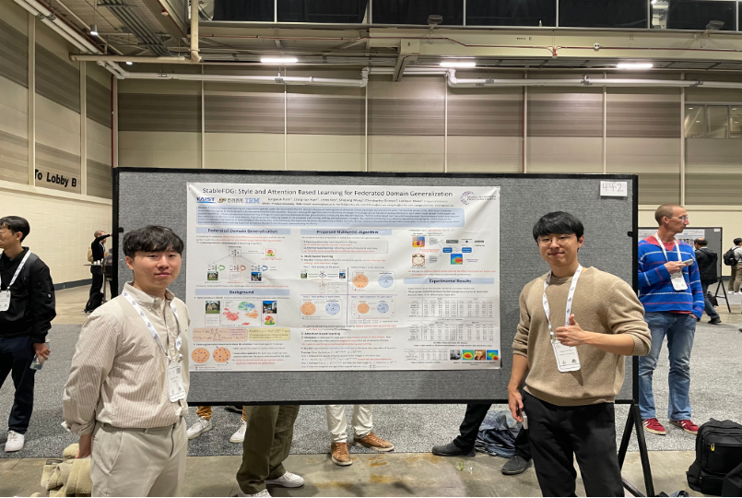
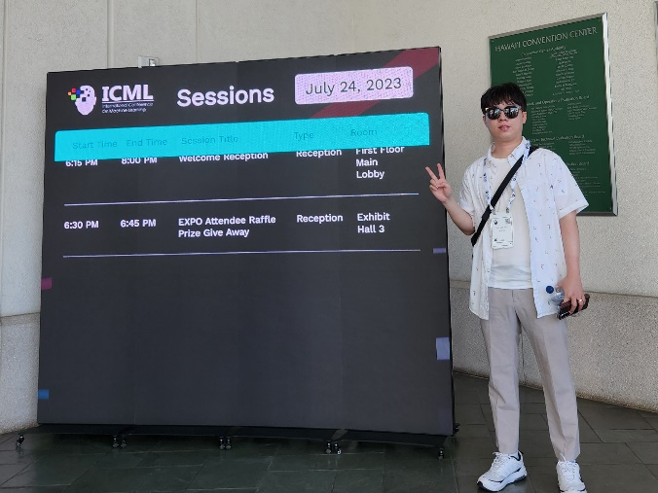
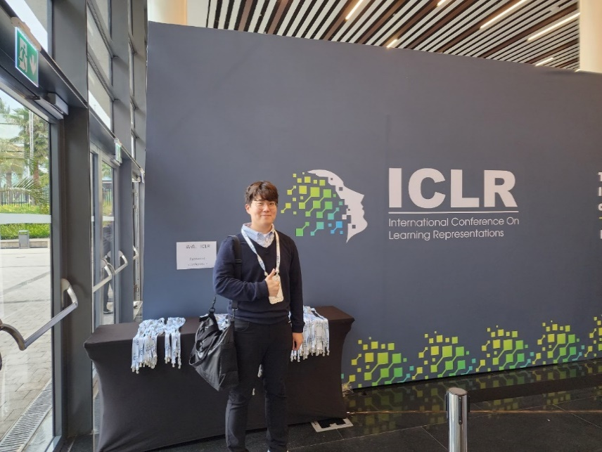
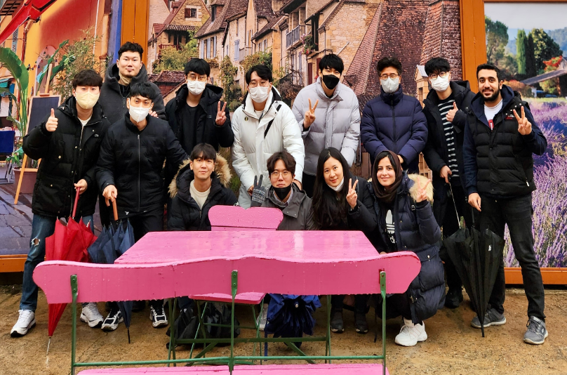
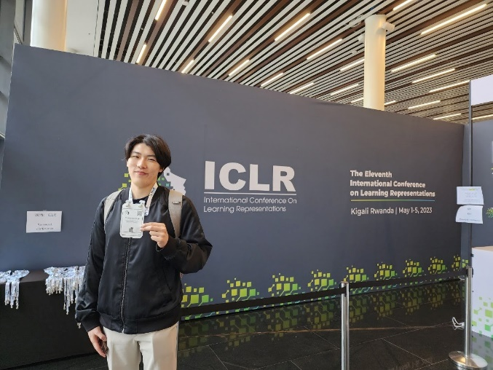
Life in MoonLab
4
2024.05 Teacher’s Day
2024.12 NeurIPS
2023.07 ICML
We’re looking for passionate students. If you have any interest, feel free to contact us! We are excited to have a wonderful time with you in MoonLab.
Contact: jmoon@kaist.edu
2023.05 ICLR
2023.01 Winter Workshop

